Slide 1
Clinic Application & Selection Process

Slide 2

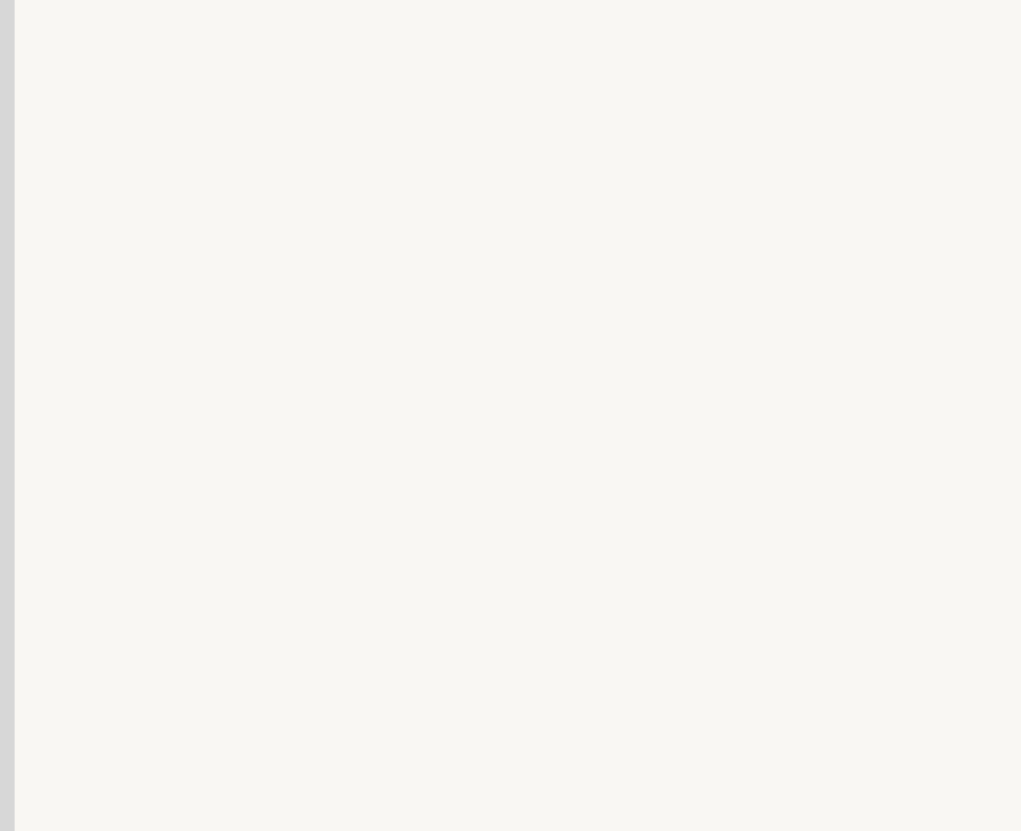
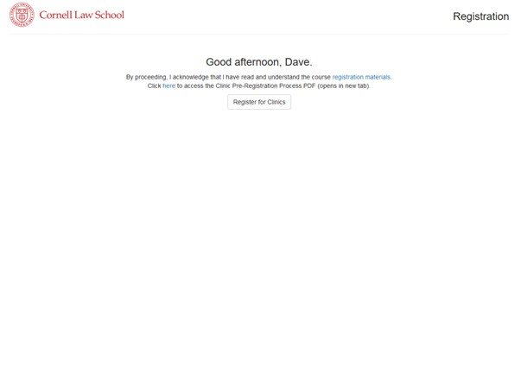

Step One
From the Launchpad - My Information - Clinic Registration.
Once you login with your NetID and password, you will be asked to sign the honor pledge (if you have not already done so). Then, you will see this screen.
Click this link to read more information about degree requirements, credit limits, etc.

Slide 3
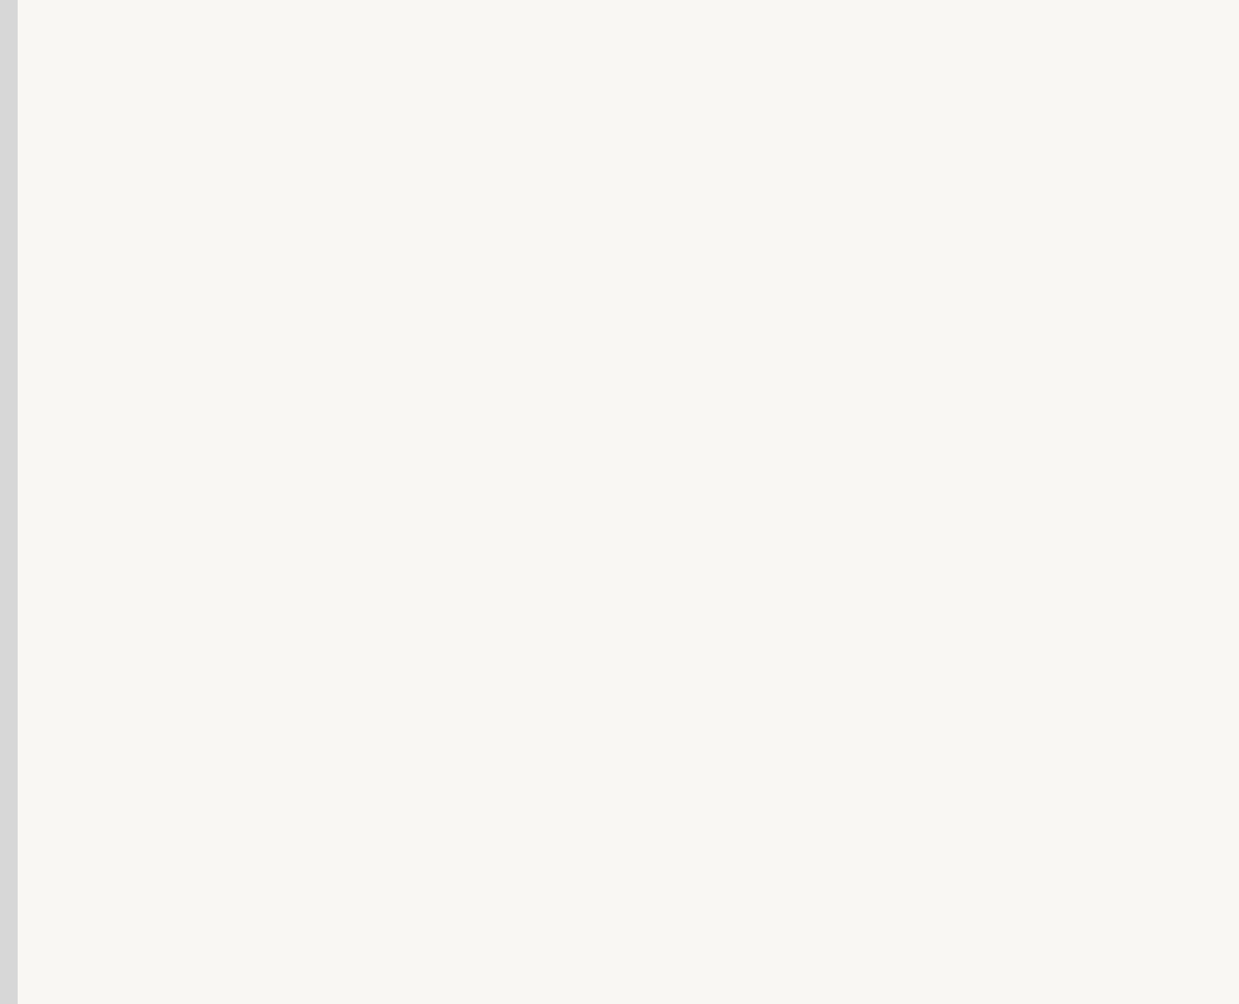
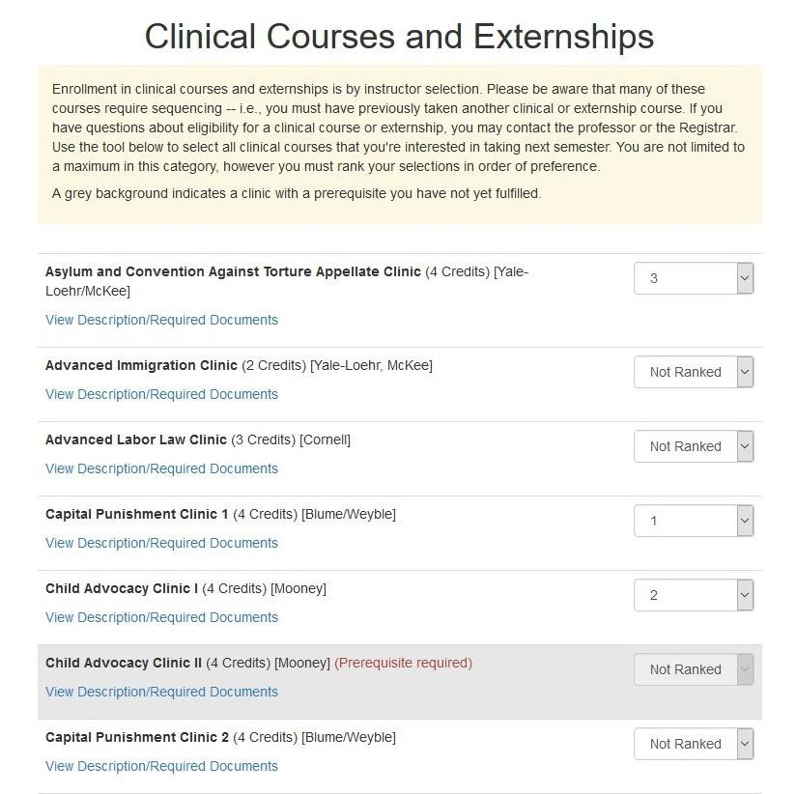

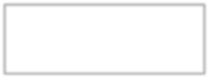

Step Two
On this screen, you will rank the clinical courses that you’re interested in taking during the Fall term
Click here to view the course description and required documents.
You can sign up for as many clinics as you’d like. You must rank your selections in order of preference.
A grey background indicates a clinic with a prerequisite you have not yet fulfilled.

Slide 4

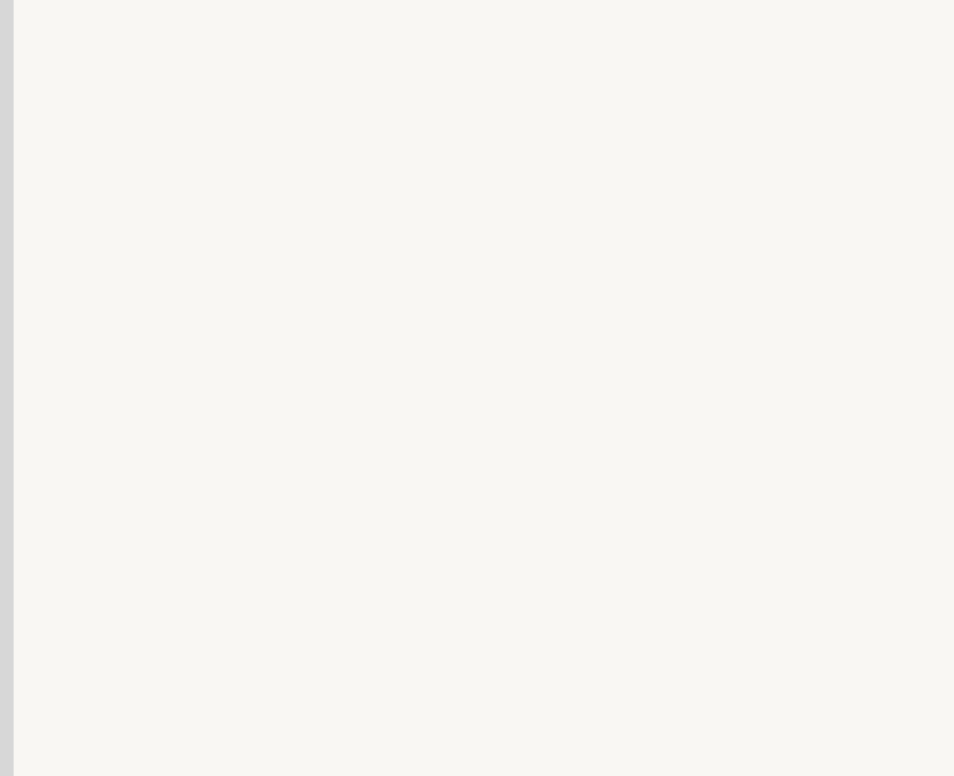
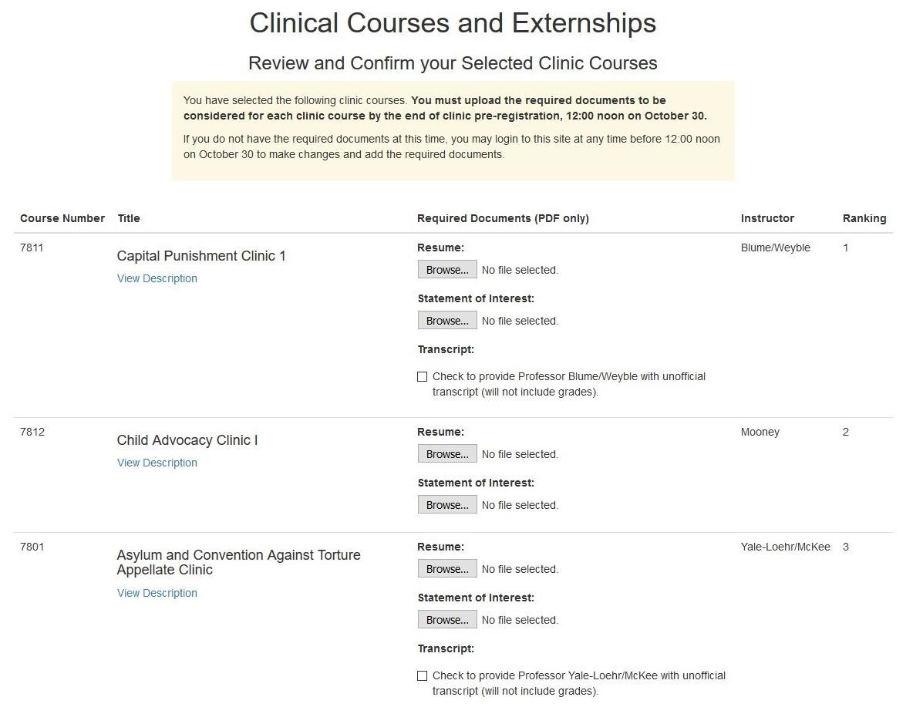
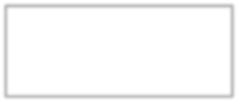
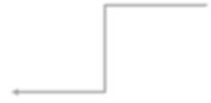


Step Three
On this screen, you will upload the required documents for each clinic.
Click the browse button to find the file on your computer. Documents must be in PDF format.
You may notice that some clinics do not require application materials.
Use this button to request an unofficial transcript (will not include grades).
Sample screen shot, dates not accurate.

Slide 5

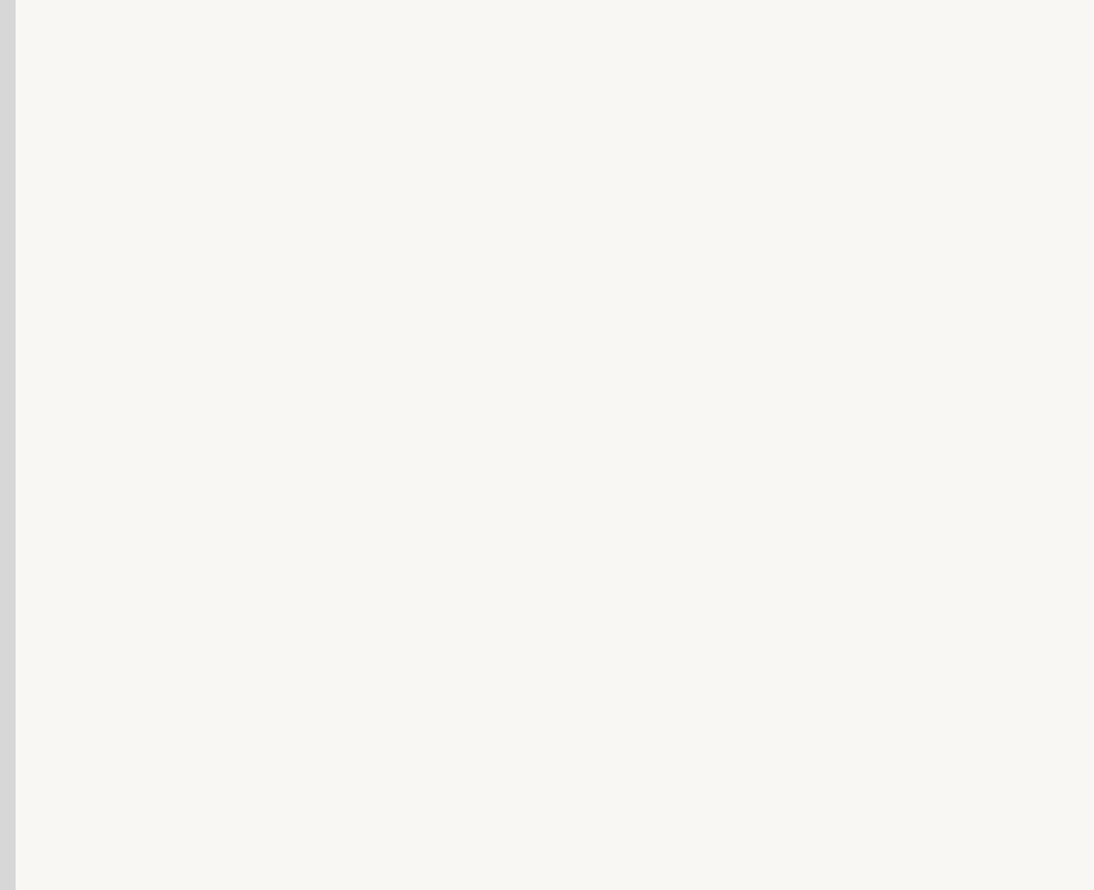
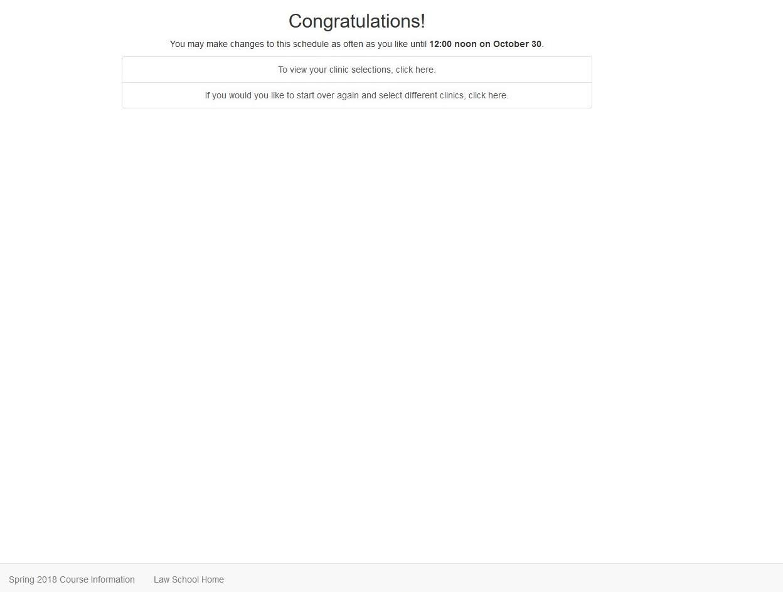
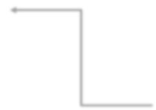
Step Four
On this screen, you will see a confirmation of your clinic registration.
Login anytime before noon to make changes to your clinic selections and/or upload application materials.
Sample screen shot, dates not accurate.

Slide 6
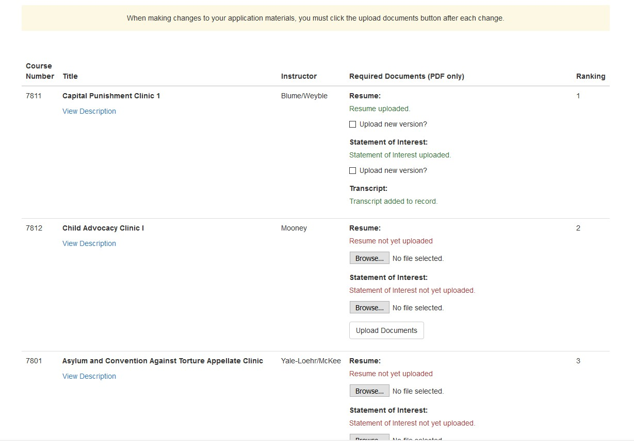
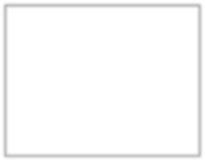
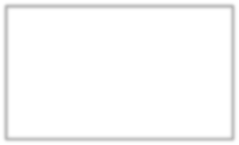

Step Five (Optional)
If you wish to make changes to your application materials, login using the clinic registration link on the Registration website. When making changes to your application materials, you must click the upload documents button after each change.
If you uploaded a document in step 3, but now want to change it, click the upload new version check box.
Then click the browse button and select the file on your computer. Click the upload documents button.
If you did not upload a document in step 3, click the browse button and select the file on your computer. Then click the upload documents button.
You should receive a pop-up that indicates the file uploaded successfully.
Sample screen shot, clinics and required documents may not be accurate.

Slide 7
What happens next?
Clinic faculty will begin reviewing all applications on October 27, 2026.
You will receive an email with your clinic status before pre-enrollment opens in November. If admitted, the Registrar’s Office will enroll you in the clinic.
You may drop clinical courses – whether enrolled or waitlisted - during the pre-enrollment period using the Clinic Drop Form, available on the Registrar’s Forms page.
If clinic faculty invite you to add a clinic, you will receive instructions on how to complete the process.
Questions? Feel free to email Clinical Program at clinicalprograms@cornell.edu if you have any questions or concerns about the clinic application and selection process.

